Slide 1
Motion Planning and Tracking FOR Autonomous vehicles
Nevindu M. Batagoda

Slide 2
Problem Statement
Generate a dynamically feasible trajectory for waypoint following of autonomous vehicles
Compare LQR and PID control for tracking the feasible trajectory
Further trajectory optimization to encode other constraints such as obstacle avoidance and curvature
Notes:
To ensure the physical soundess of …

Slide 3
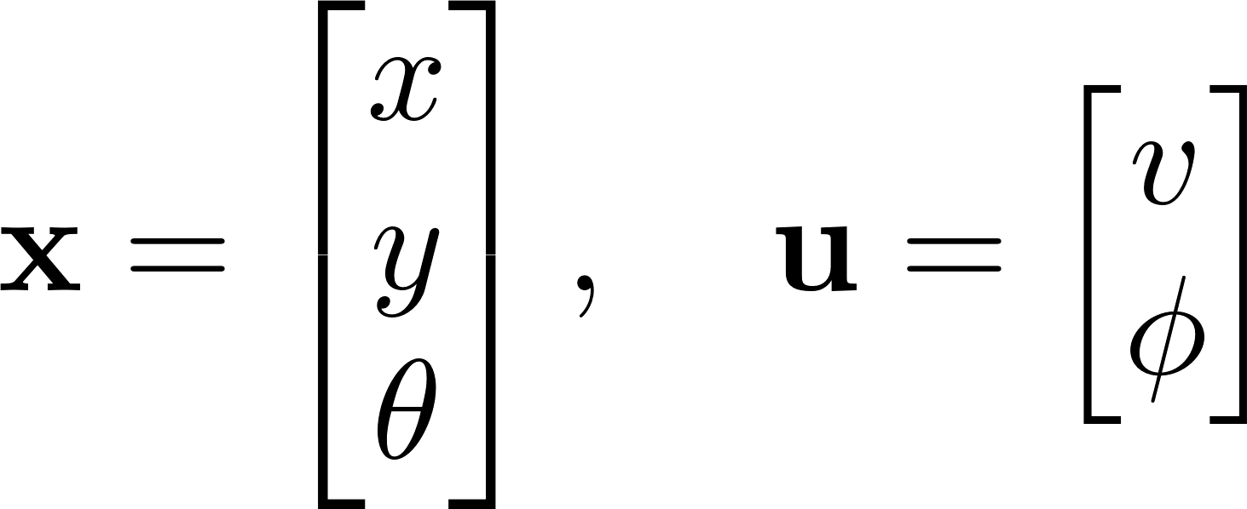

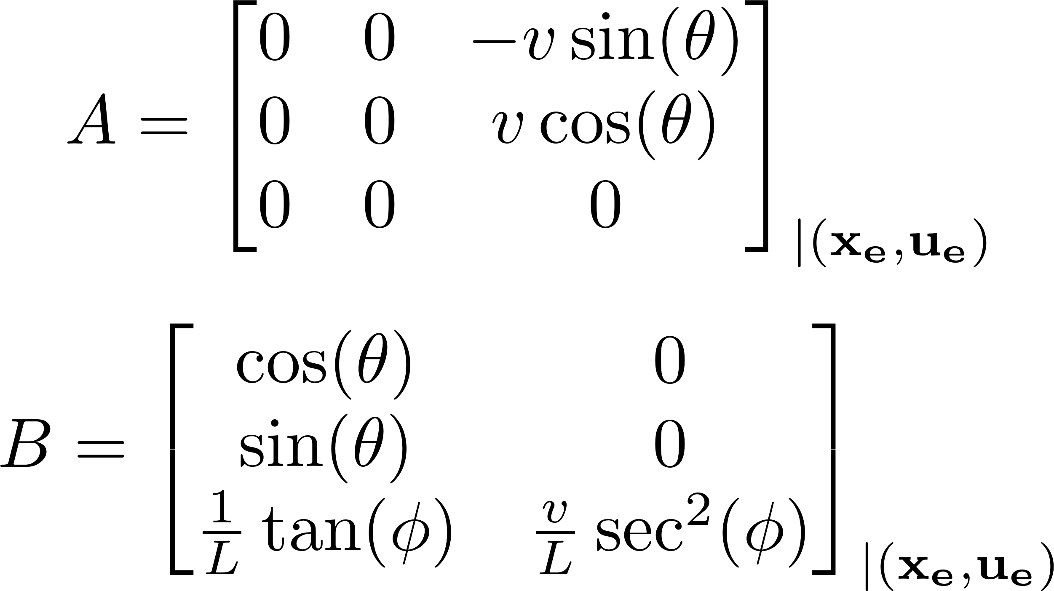
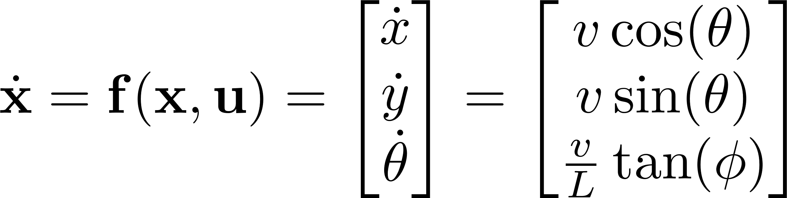
Kinematics Bicycle Model
State space form
Linearized model

Slide 4
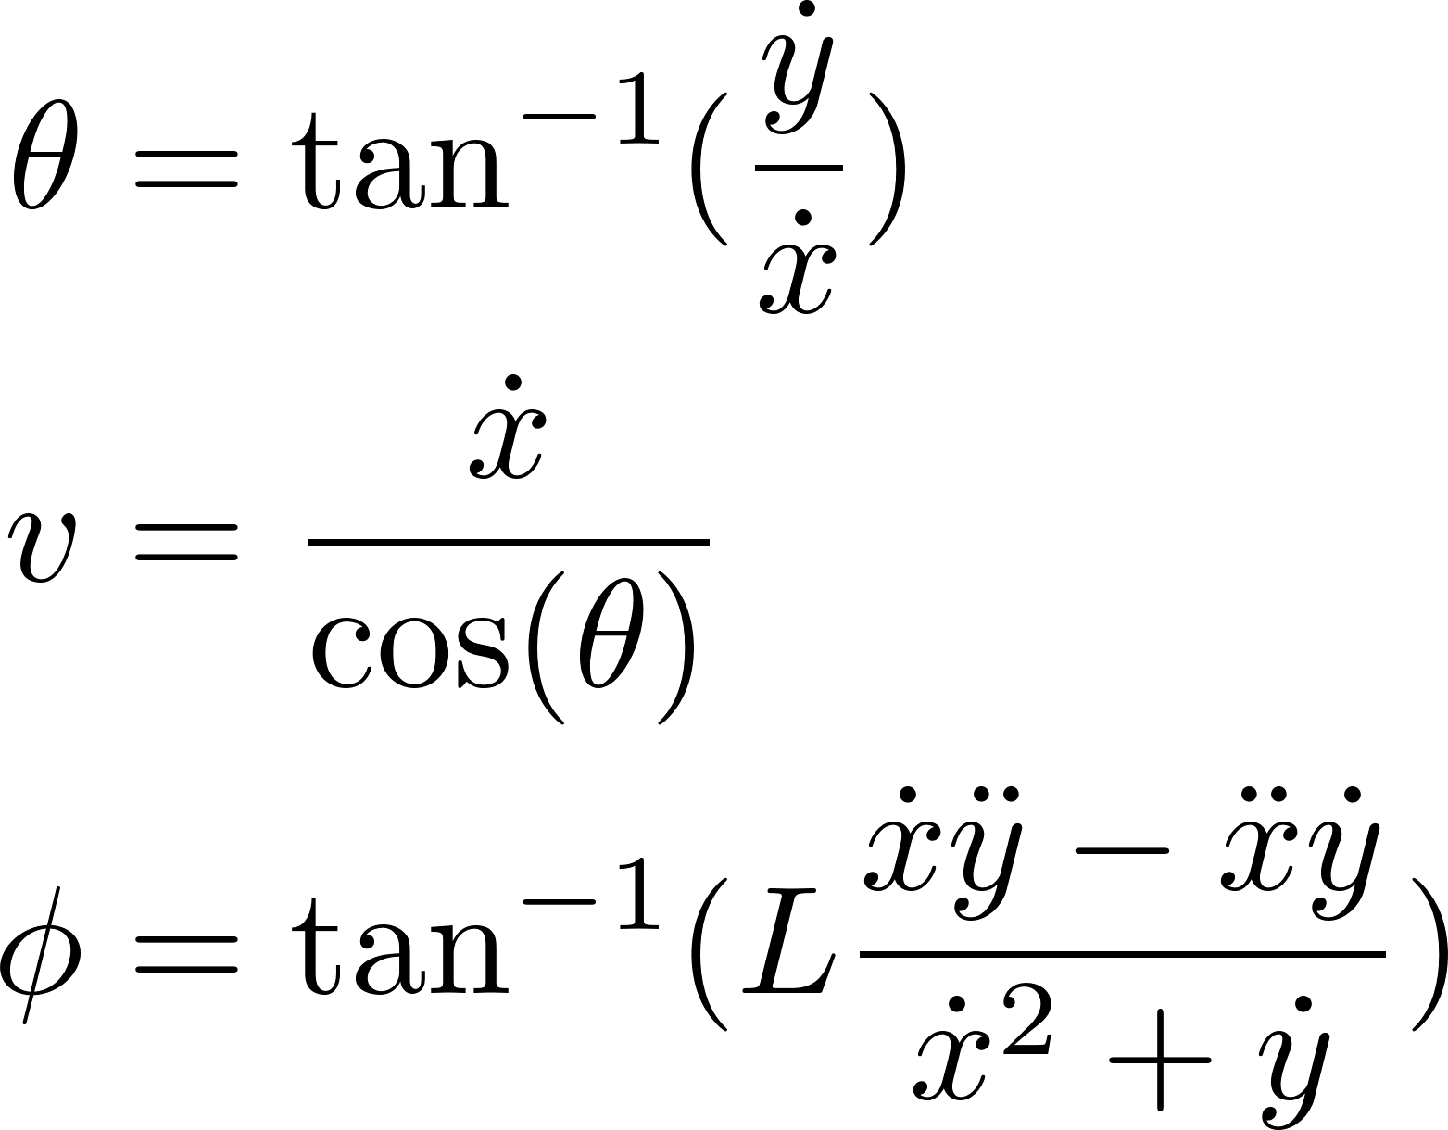
Differential Flatness of the Bicycle Model
The bicycle mode is differentially flat for a flat output space of x and y position
As such any trajectory on the (x,y) space is dynamically feasible

Slide 5
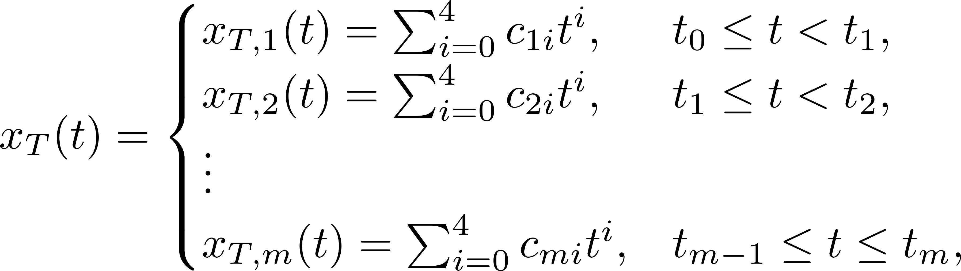
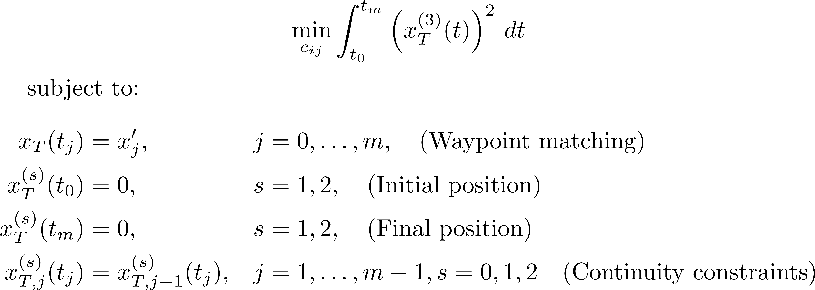
Trajectory Generation
Generate a minimum jerk (x,y) - trajectory made of piecewise 4th order polynomials between each provided waypoint

Slide 6
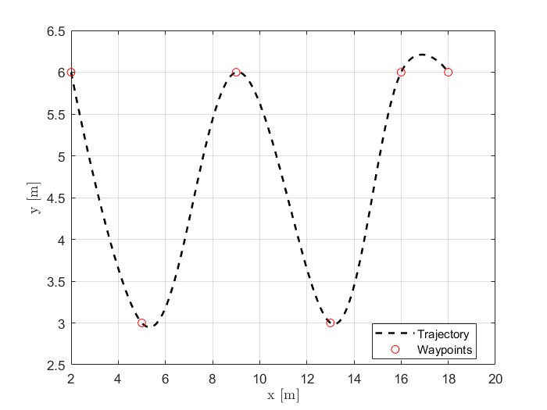
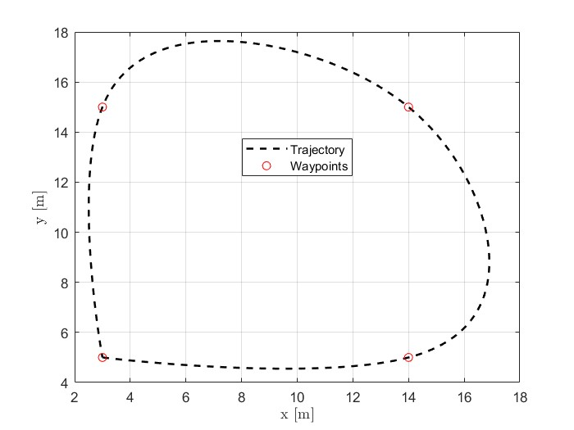
Trajectory Examples
“sinusoidal “ trajectory
Looping trajectory

Slide 7
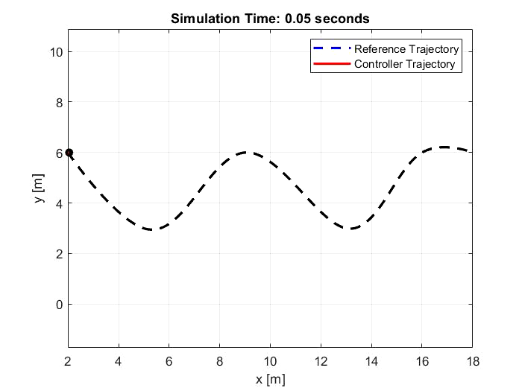
LQR Controller: Sinusoidal Trajectory
The model is Linearized at each reference point along the trajectory and tracks the error dynamics

Slide 8
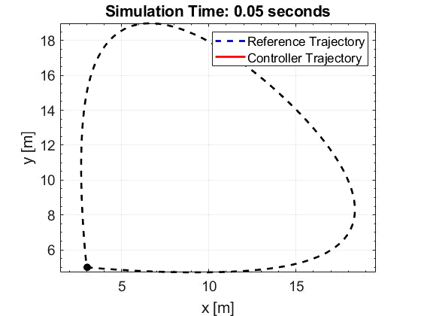
LQR Controller: Looping Trajectory
Quite abysmal! Possibly due to an issue with handling the reference heading

Slide 9
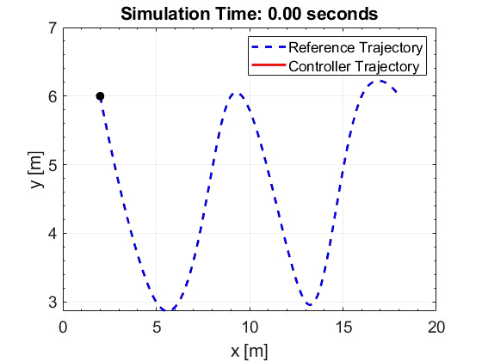
PID Controller: Sinusoidal Trajectory
Two controllers for velocity and heading based on error state

Slide 10
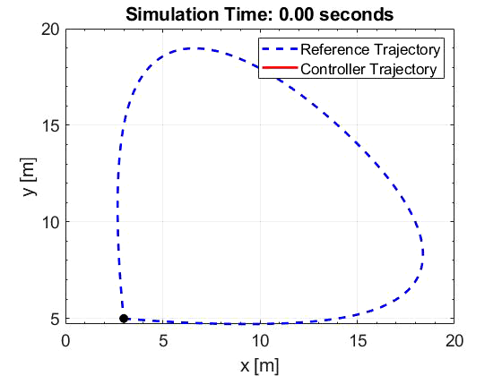
PID Controller: Looping Trajectory

Slide 11
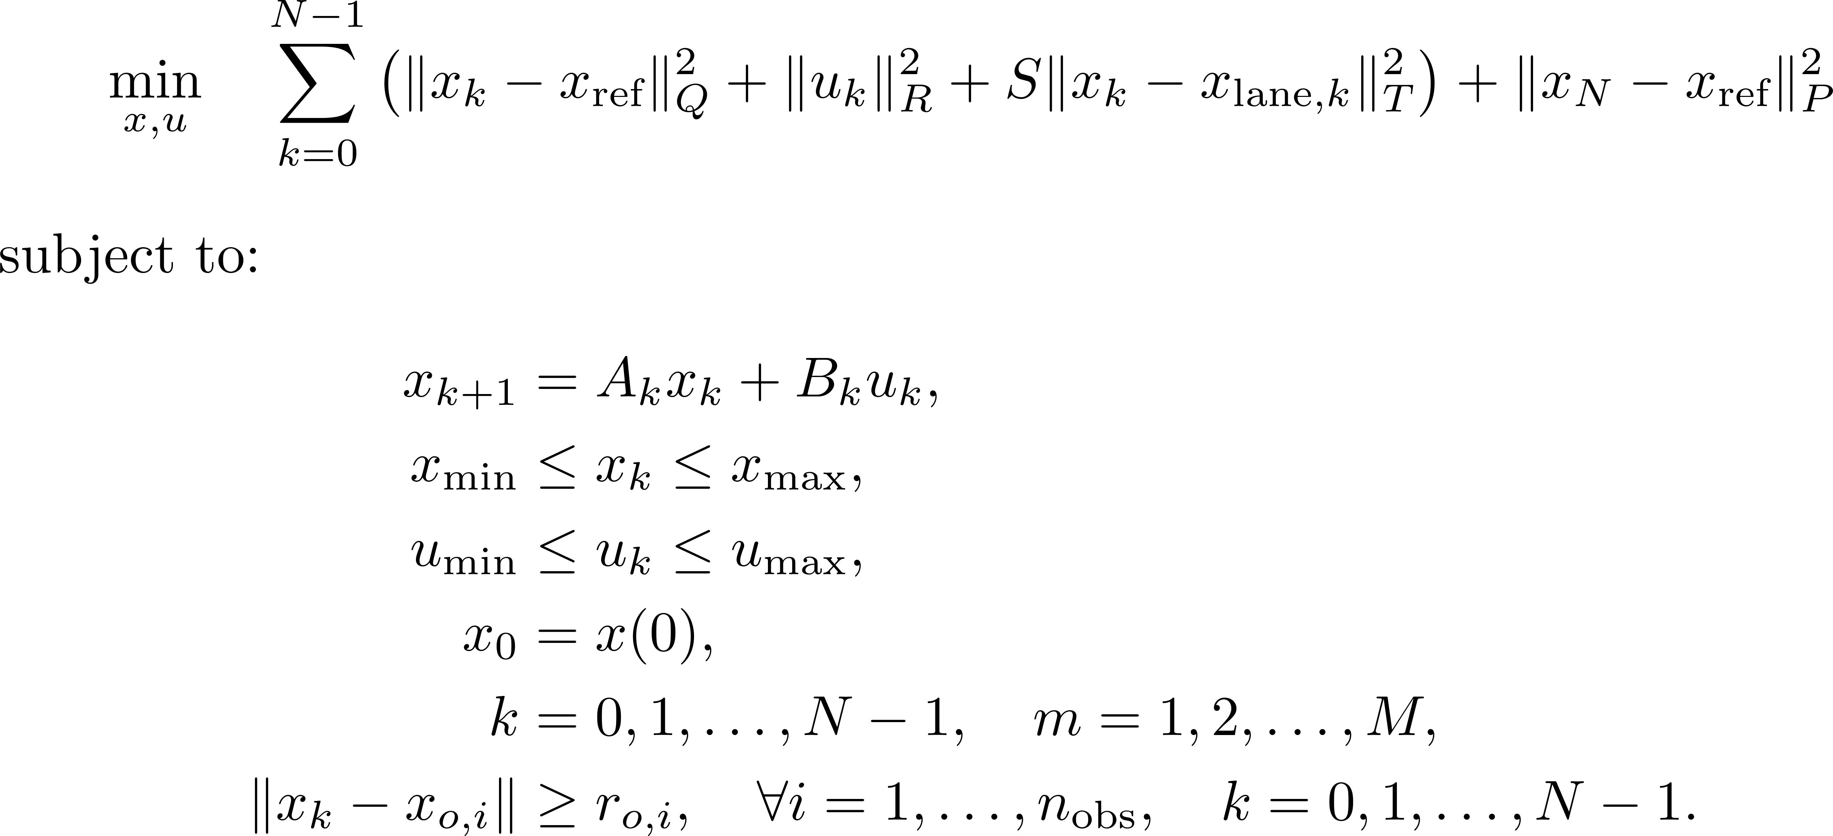
Trajectory Optimization using MPC (In progress)
Trajectory generation method is optimized separately for each x and y trajectory
Difficult to encode constraints such as obstacle avoidance and lane centerline tracking

Slide 12
Discussion
PID controller was much better at tracking the trajectory compared to LQR
LQR controller needs further debugging with regards to the abnormalities in heading error state handling and tuning
Future work includes designing the MPC trajectory optimization method. Initial attempt using Julia.

Slide 13
Thank You!

